Slide 1
Furniture ordering system

Slide 2
Group members
10014466 - K.A. Malith Sachintha Samarasinghe
10014356 - L.K.L. Perera
10014386 – P.M.D.C. Munasinghe
10014284 – J.Sasindu M. Jambugaswaththa
10014322 – K.M.N.S.C. Kumarasinghe

Slide 3
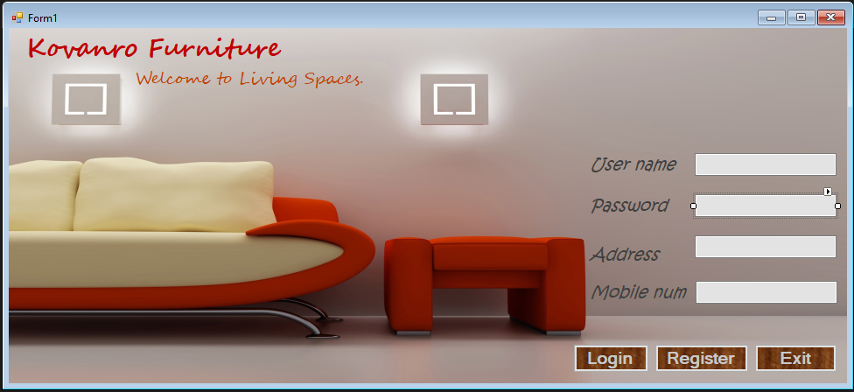
Register Form

Slide 4
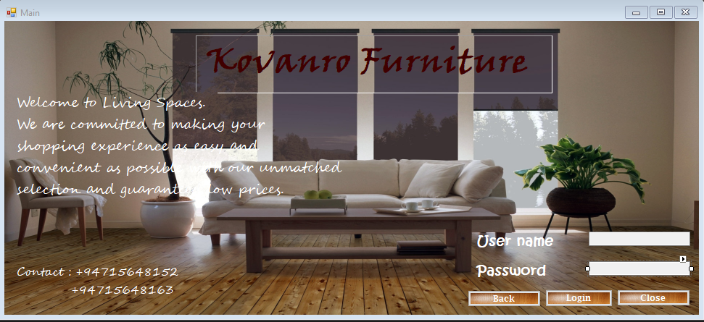
Login Form

Slide 5
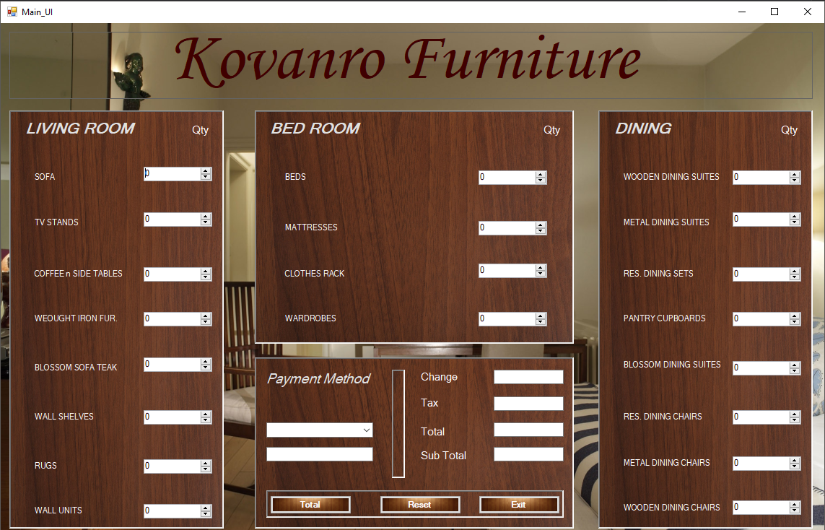

Slide 6
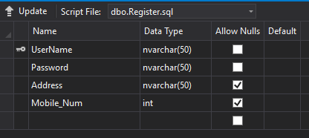
Register Table Info.

Slide 7
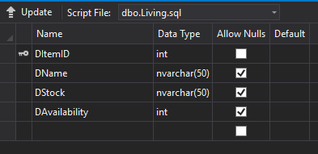
Dining room Table Info.

Slide 8
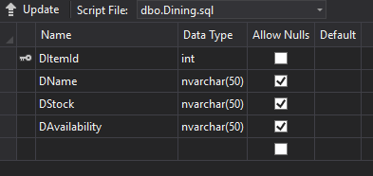
Dining room Table Info.

Slide 9
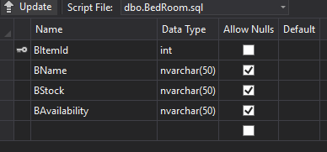
Living room Table Info.

Slide 10
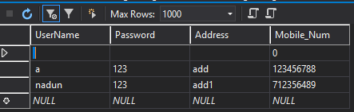
Register room Table

Slide 11
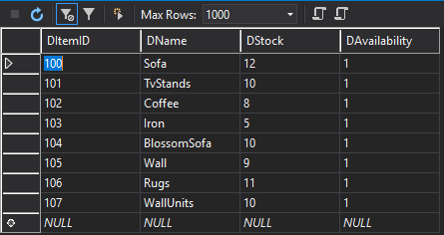
Dining room Table

Slide 12
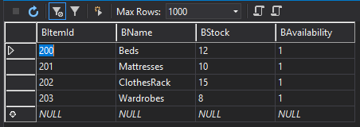
Bed room Table

Slide 13
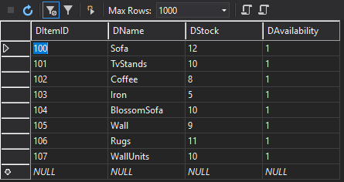
Dining room Table

Slide 14
Thank you!!

